Slide 1


Git and GitHub
Prepared by: Hala Majdalawi

Slide 2
Learning Objectives
Git
GitHub
Create a Git project
Git branches

Slide 3

Git

Slide 4
Git
Git : is a control system used to monitor code changes when developing software. It allows developers to work on one project at a time, monitor modifications, make it easier for them to collaborate with one another, and easily branch and merge code. Git is operating locally on the developer's computer, enabling them to manage the code, make changes, and create branches.

Slide 5
Advantages of Git
Anyone may use it because it is open source and cost nothing.
Secure uses the secure hashing function, a particular hashing technique, to encrypt the database in order to safeguard it.
It is versatile in usage and can handle a lot of operations.
All kinds of gadgets may use the Git system.
Small in size and quick to use.

Slide 6
Disadvantages of Git
The Git system is unable to handle binary files, and switching the file to one without text causes it to operate slowly.
This is a really bad thing if you don't know how to use the Git system or have any comprehension of it.
You must be clear about what you intend to achieve since it is possible to execute an order or program incorrectly.
It's probable that there are differences in approach amongst the developers, which makes issues more difficult to settle.

Slide 7
Git
Tracking code changes
Coding collaboration
Tracking who made changes

Slide 8
How Does Git Function?
Each Git project's files go through a number of stages:
When a file is marked as modified, it has undergone changes, but you have not yet committed them to your local database.
Staged refers to the designation of a changed file in its present state for inclusion in your subsequent commit snapshot.
Data that has been committed to your local database (Repository) is securely kept there. In GIT, repositories are collections of files from several Project versions.

Slide 9
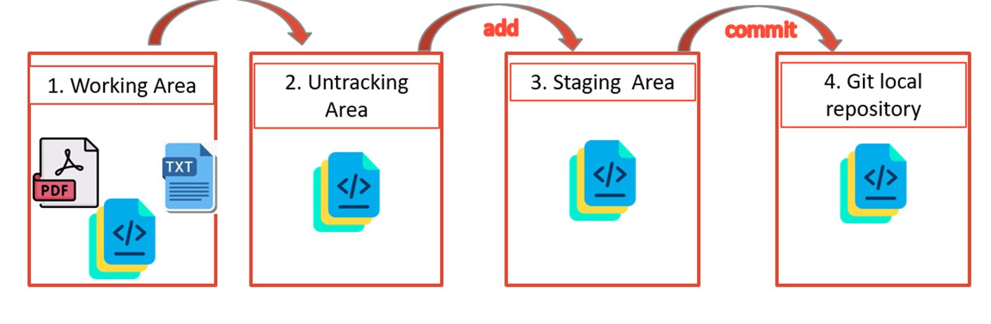
The basic Git workflow

Slide 10
Installing Git
Download Git Bash for Windows using this link https://git-scm.com/download/win
Fedora
$ sudo dnf install git-all
Ubuntu
$ sudo apt install git-all
You can do this simply by trying to run git from the Terminal the very first time.
Windows
Linux
macOS

Slide 11
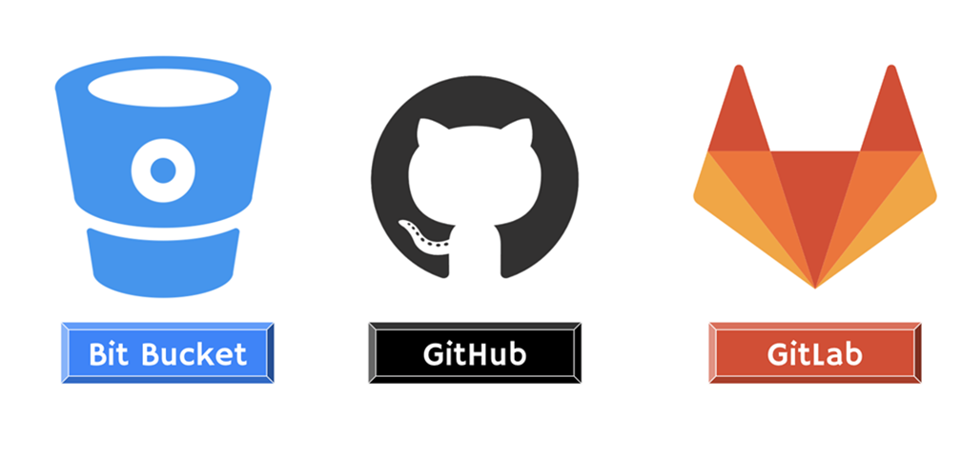
Git hosting services platforms

Slide 12

GitHub

Slide 13
GitHub
GitHub On the web, you may find this fundamental system. This system is regarded as a social coding platform since it works to provide hosting services for Git repositories as well as other functionality based on Git.
Additionally, anyone involved in the development process may host their own Git repositories on GitHub and benefit from tools like pull requests, monitoring and managing potential bugs in existing code, and the capacity to review code in a project. With the aid of GitHub, users may finish projects while working concurrently from various locations. This system is open source, and the larger community has access to the project code.

Slide 14
Advantages of GitHub
- It enables the creation of formatted documents using a basic text editor. To monitor bugs and user input, the GitHub system also enables online repository services.
- It offers a Git process and information for a ready-to-demonstrate how-to for creating SSH keys.
- The GitHub system includes gist pages that enable adding static websites using HTML pages from a single file into a Git project. This device has the capacity to quickly track file changes.
- A robust version of the software that can easily handle branching and merging is part of the GitHub system.

Slide 15
Disadvantages of GitHub
- Because GitHub is such a potent tool, even beginners will have trouble using it for the first time.
- This approach offers GitHub exclusive repositories at both the free and subscription tiers, however there are certain issues with very valuable intellectual property.
- Due to cost, GitHub capabilities and features on online repositories are restricted.

Slide 16
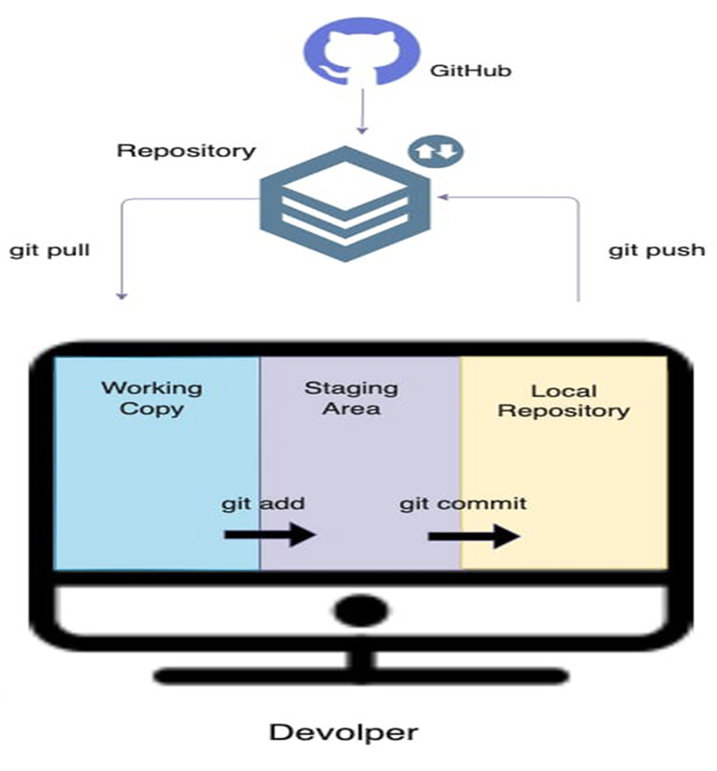
Git and GitHub workflow

Slide 17

GitHub Account

Slide 18
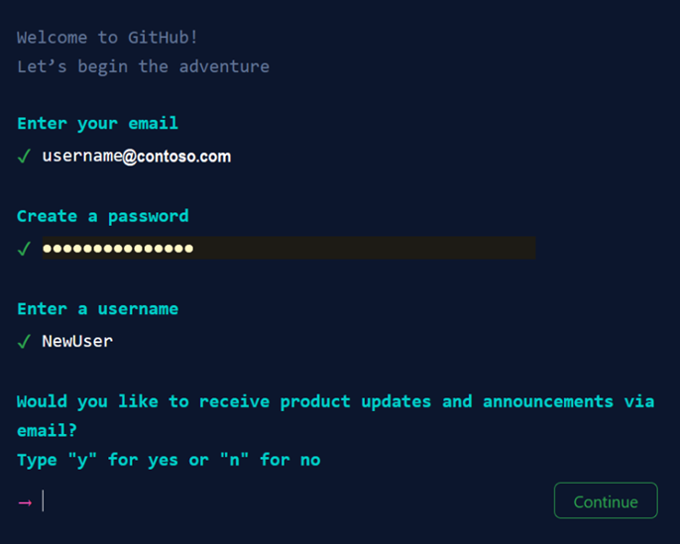
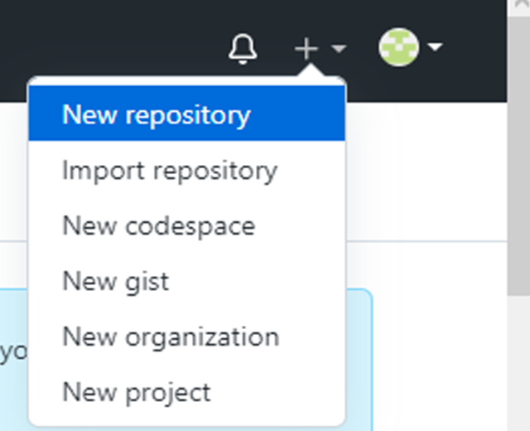
GitHub Account

Slide 19
Git Configuration
$ git config --global user.name "username"
$ git config --global user.email “sign up email”

Slide 20
Create new git project
Step 1:
We need to initialize git in the desired project.
Step 2:
We need to list the files in this directory by typing :
- ls → list the files in the directory.
ls -a → list all files, including hidden files.
Step 3:
We need to see which changes have been staged, which haven't, and which files aren't being tracked .
Step 4:
we need to add the untracked files into the staging environment.

Slide 21
Create new git project
Step 5:
we need to recheck the status of the files.
Step 6:
We need to transform the files from the staging environment into the local repository by using the commit git command.
When we use commit, we should always include a message.

Slide 22
Create new git project
Step 7:
Since we have already set up a local Git repo, we are going to push that to GitHub.
Step 8:
we are going to push our master branch to the origin URL, and set it as the default remote branch.

Slide 23
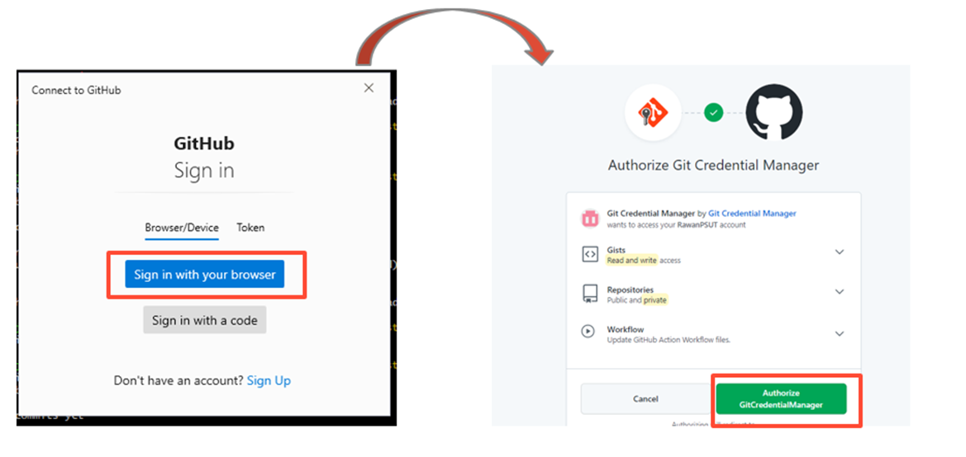
Create new git project
Since this is your first time connecting to GitHub, you will get a notification to authenticate this connection.

Slide 24
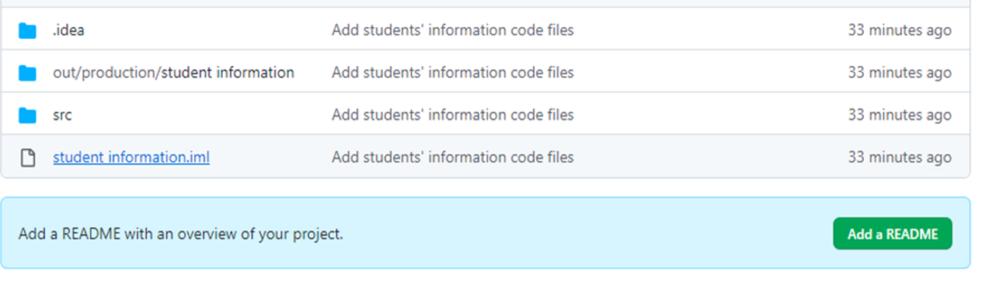
Create new git project
Step 9:
Return back to the Bash terminal .
Step 10:
Go back into GitHub and see that the repository has been updated.

Slide 25

Git Branch

Slide 26
Git Branch
Git refers to the original branch as the master/main branch/default branch. When making additional commits, the master/main branch will always connect you to the most recent changes you will make. A branch is a specific line of code that programmers working on a project employ to make new commits.

Slide 27
Git Branch
A group of developers can create copies of the production they are working on thanks to Git branching. They may create new features and repair issues while working in the git environment. Git will allow merging the modifications into the main production whenever they are pleased with the changes.

Slide 28
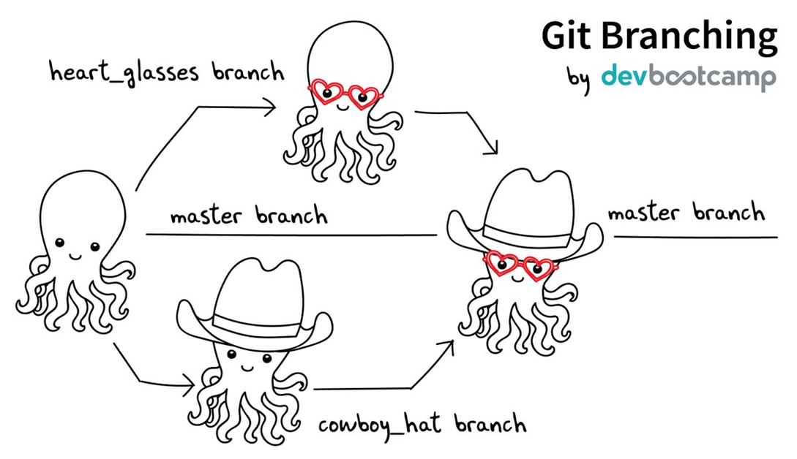
Git Branch

Slide 29
Git Branch
With the git branch command, you may view all of our main branch's branches.
In a live repository, the git branch -a command often samples both local and remote branches.

Slide 30

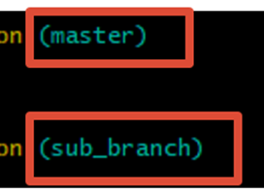
Create new branch
Step 1:
We need to create a local branch which is named: sub_branch from the master branch and list the branches name again.
Step 2:
We need to change the head pointer to the newest branch.

Slide 31
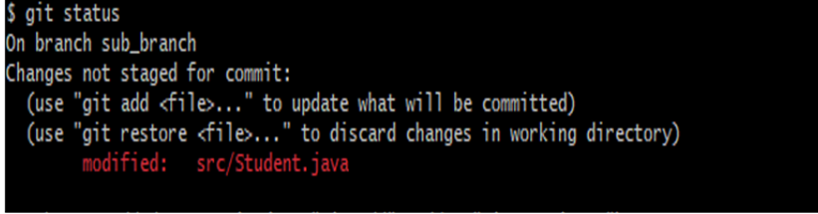

Create new branch
Step 3:
make any changes to the main class, and complete the rest steps to push the new changes into the new branch.

Slide 32
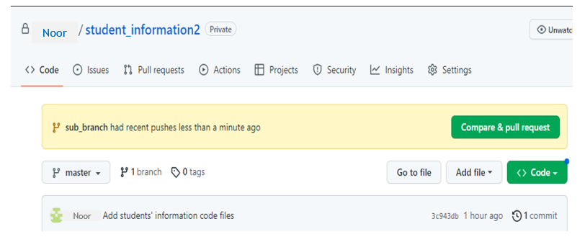
Create new branch
Step 4:
pull the new changes and make marge between sub_branch and master branch.

Slide 33
Thank You ^.^

Slide 34
References
watson, O. (2021a) Git: Advantages and disadvantages, Bodhi Zazen. Available at: https://bodhizazen.net/git-advantages-and-disadvantages/ (Accessed: 22 May 2023).
CodeClouds (2022) The Pros and cons of using github for repository management, CodeClouds. Available at: https://www.codeclouds.com/blog/advantages-disadvantages-using-github/ (Accessed: 22 May 2023).
(No date a) Google search. Available at: https://www.google.com/search?q=how%2Bto%2Bcreate%2Ban%2Baccount%2Bin%2BGitHub&amp;sxsrf=APwXEdeRhKbmkZzPXaiRkaBk7iX_j6Falg%3A1684743373937&amp;source=lnms&amp;tbm=isch&amp;sa=X&amp;ved=2ahUKEwjHhN2Svoj_AhUZUaQEHXNEDdwQ_AUoAnoECAIQBA&amp;biw=1536&amp;bih=722&amp;dpr=1.25#imgrc=i_zTrAYshNzboM (Accessed: 22 May 2023).

